Slide 1

CALL RECORDS PROCESSING
Instructor: Latifur Khan
Team Members
Aurko Ghosh
Venkatesh Poosarla
Sumit K Sikhwal
Chaitanya Vejendla
Siva Teja Kambham
Nagarjuna Manchineni
Vishal Kankanala
create your future
www.utdallas.edu

Slide 2
Dataset used:
Size: 19MB
Columns: user-id, date, call-duration, latitude, longitude
Each entry in the data set contains one end of a call.
Assumption made:
If two or more users have the same record with respect to time of call, duration of call and date they are talking amongst themselves.
create your future
www.utdallas.edu

Slide 3
ALGORITHMS USED:
K-means: for unstructured learning and predicting the deciding features.
Nearest neighbor: Predicting new features for new users.
Decision-Tree: for recommendations.
create your future
www.utdallas.edu

Slide 4
K-means algorithm
k-means clustering is a method of vector quantization, originally from signal processing, that is popular for cluster analysis in data mining. k-means clustering aims to partition n observations into k clusters in which each observation belongs to the cluster with the nearest mean, serving as a prototype of the cluster.
The problem is computationally difficult (NP-hard); however, there are efficient heuristic algorithms that are commonly employed and converge quickly to a local optimum. These are usually similar to the expectation-maximization algorithm for mixtures of Gaussian distributions via an iterative refinement approach employed by both algorithms.
create your future
www.utdallas.edu

Slide 5
Nearest neighbor algorithm
The nearest neighbour algorithm was one of the first algorithms used to determine a solution to the travelling salesman problem. In it, the salesman starts at a random city and repeatedly visits the nearest city until all have been visited. It quickly yields a short tour, but usually not the optimal one.
These are the steps of the algorithm:
  start on an arbitrary vertex as current vertex.
  find out the shortest edge connecting current vertex and an unvisited vertex V.
  set current vertex to V.
  mark V as visited.
  if all the vertices in domain are visited, then terminate.
  Go to step 2.
create your future
www.utdallas.edu

Slide 6
TECHNOLOGIES USED
Spark
Hive
R
create your future
www.utdallas.edu

Slide 7
Project flow
Spark and R used to create clusters.
Compared accuracies using SSE.
Used hive queries on the cluster.
A part of data is used as test data and passed through decision tree to classify them into zones based on behavioral pattern of calls.
Recommends useful plans to users grouped in each of the above classes.
Data visualization of users on world map based on location.(Visualization can be provided based on any criteria)
create your future
www.utdallas.edu

Slide 8
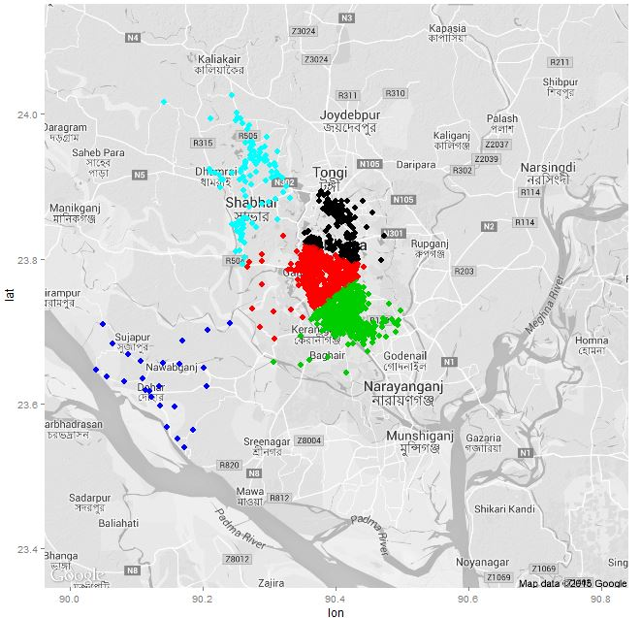
Results
create your future
www.utdallas.edu

Slide 9
Frequently called users
The list of frequently called numbers for a particular person at a given time period are stored.
The top three entries in this list are given as recommendations to that user
create your future
www.utdallas.edu

Slide 10
Defining plans for users
Attributes: Cluster centroids of latitude-longitude and call duration
Target class: Plans for the users
The above is used as a training data.
This is used to recommend plans for new users using nearest neighbor algorithm.

Slide 11
Output summary
Multiple analysis on the data were done and various results were derived.
Prediction of calls between two users.
Frequently contacted users.
Average call durations for users in different zones.
Built a recommendation system for suggesting better user plans.
create your future
www.utdallas.edu

Slide 12
Place
Duration
create your future
www.utdallas.edu

Slide 13
create your future
www.utdallas.edu

